Slide 1




Shock Boundary Layer Interaction Visualization Techniques
John Bruchhagen
Mentor: Dr. James Threadgill
Arizona NASA Space Grant Symposium – Tempe, Arizona
April 18th, 2026

Slide 2
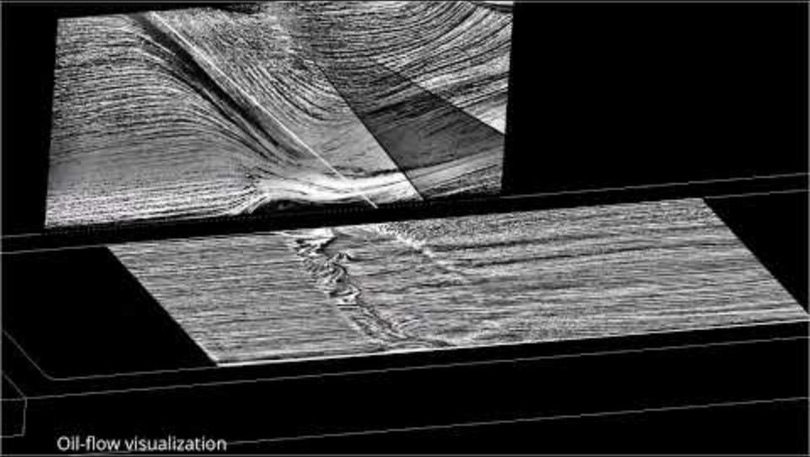
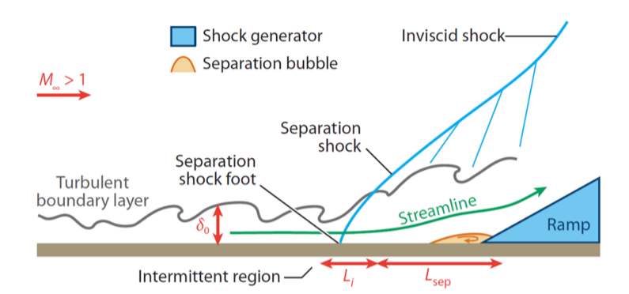
Introduction
Supersonic flows can be highly unsteady
Flow separation is airflow detaching from surface
  Occurs due to adverse pressure gradient
  Leads to unsteady forces that must be investigated
Source: Lennart Rohlfs 2022
Source: Ethan Bolze 2024
Notes:
h

Slide 3
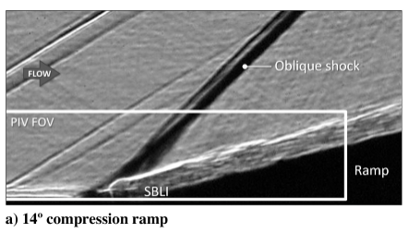
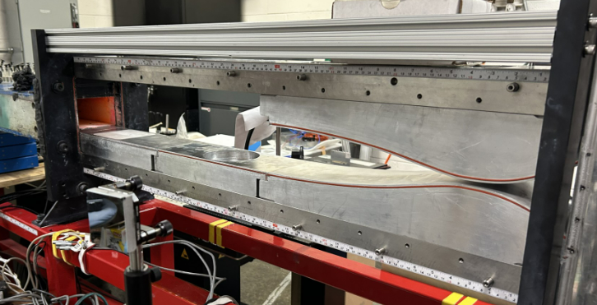
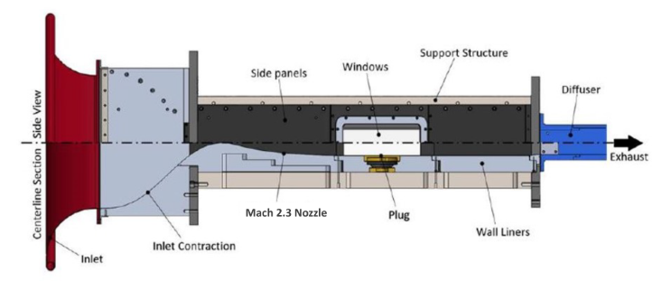
Objective
Visualize shock boundary layer interactions
Compare different imaging methods
Find best applications for each technique
Tests done using University of Arizona’s Indraft Supersonic Wind Tunnel (ISWT)
  Low enthalpy, vacuum, high speed wind tunnel
  Run time 10-15 seconds
  Tests performed at Mach 2.3
Source: James Threadgill 2020
Notes:
h

Slide 4
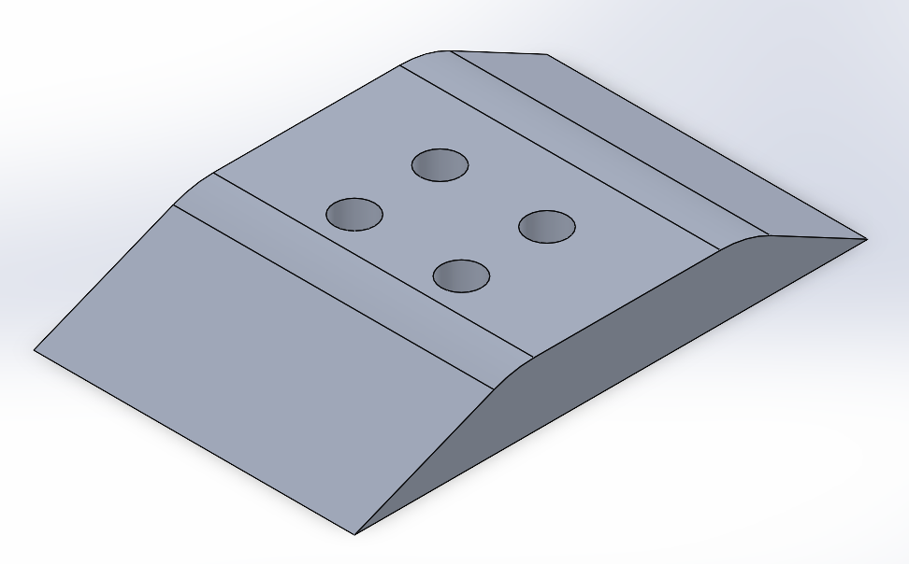
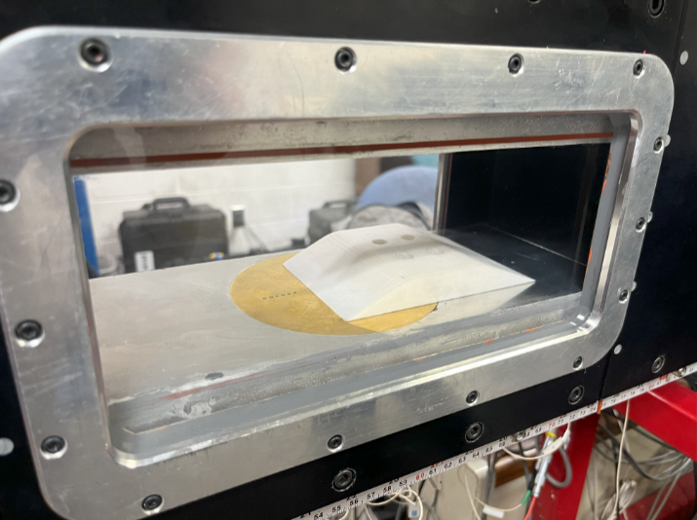
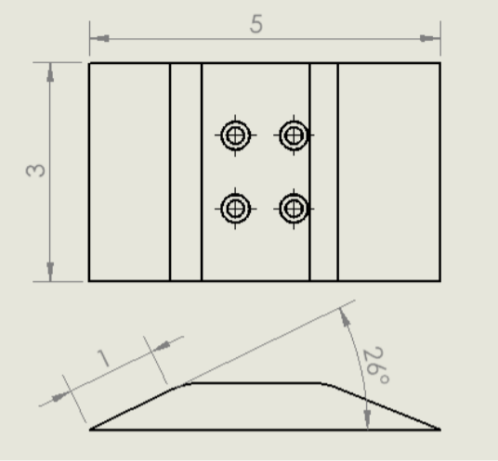
Methods
Used 26-degree ramp to generate shock
Designed in SolidWorks
Printed with 10K Rigid resin

Slide 5
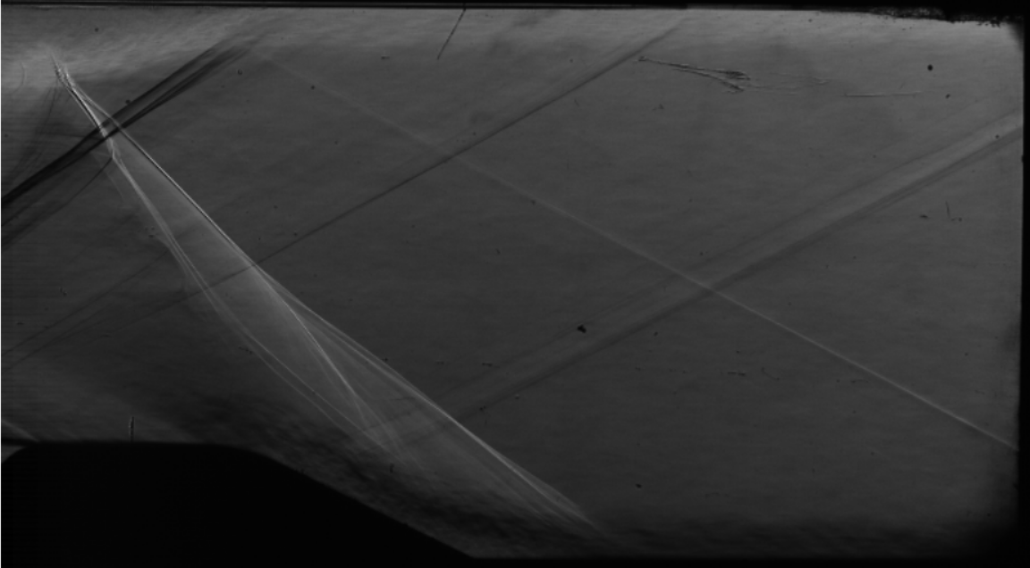
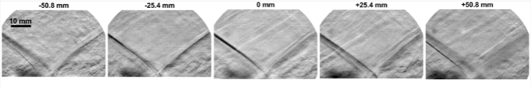
Methods
Snapshot of Z-type Schlieren
Z-type Schlieren
  View of entire depth of test section
Focusing Schlieren
  Creates depth of field smaller than entire light path
Both use light to visualize density gradients of air due to light refraction being proportional to density of a medium
Focus Schlieren at different depths
Source: Zachary Riley 2025
Notes:
H

Slide 6
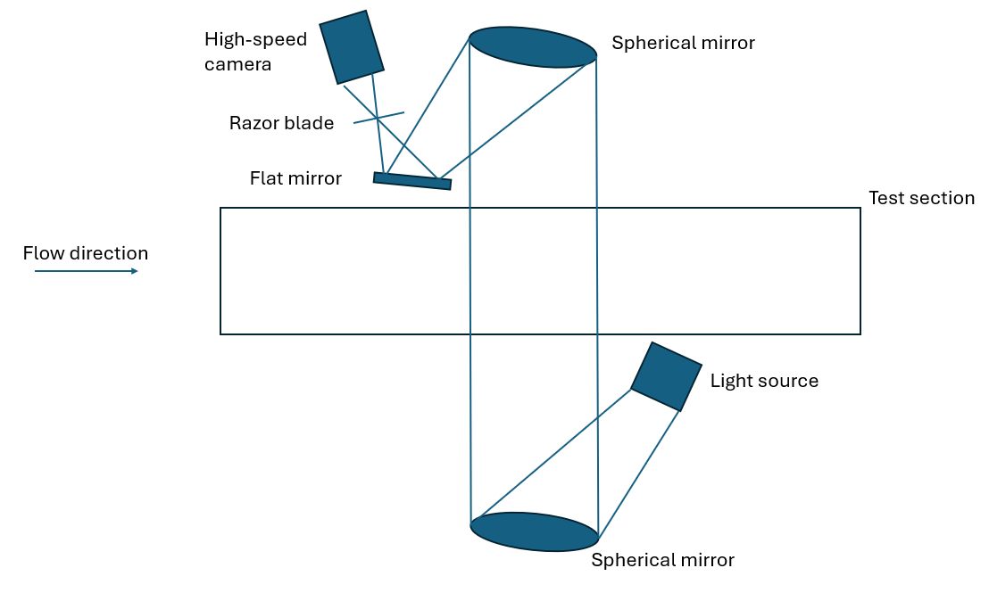
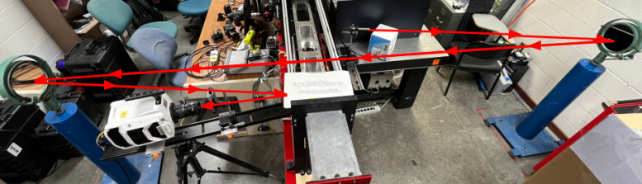
Z-type Schlieren
Z-type Schlieren uses a light source, spherical mirrors, and a razor blade to cut light
Captures entire depth of test section
Experimented with aperture of light source, found 4.25 mm light optimal with ISWT setup
Lower aperture leads to more sensitivity
Higher aperture leads to larger range of values
Source: Alec Maloney 2025
Notes:
H

Slide 7
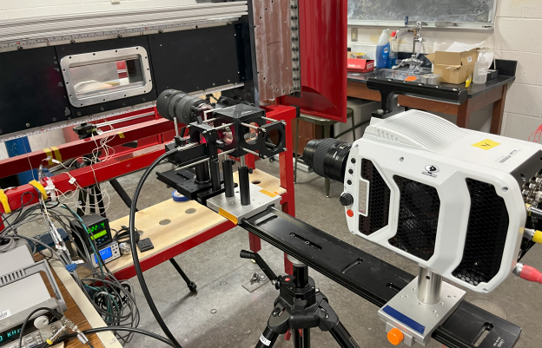
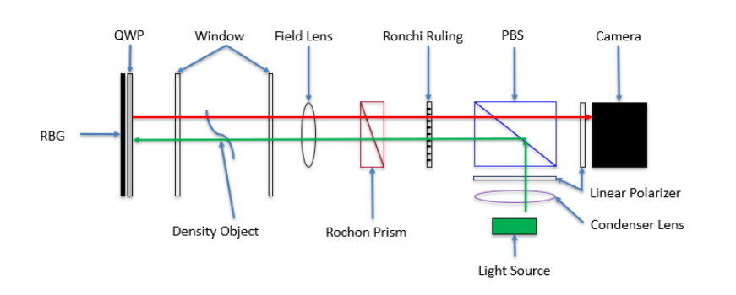
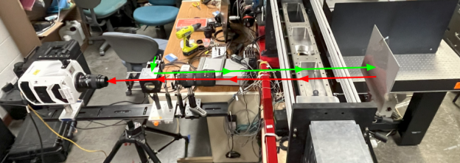
Focusing Schlieren
Data/images from focusing Schlieren used from Alec Maloney
Uses grid background and optics to detect small deflections of light
Effectively lots of z-type Schlieren done in parallel
Only light from focal plane is sharp, outside disturbances are blurred
Allows camera to focus on smaller depth field rather than entire test section
Can capture 3D structures across the span of the test section
Source: Alec Maloney 2025
Source: Alec Maloney 2025
Source: Alec Maloney 2025
Notes:
H

Slide 8
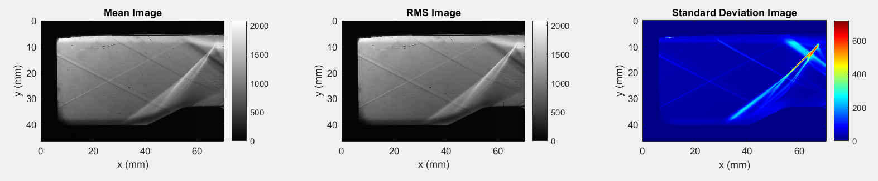
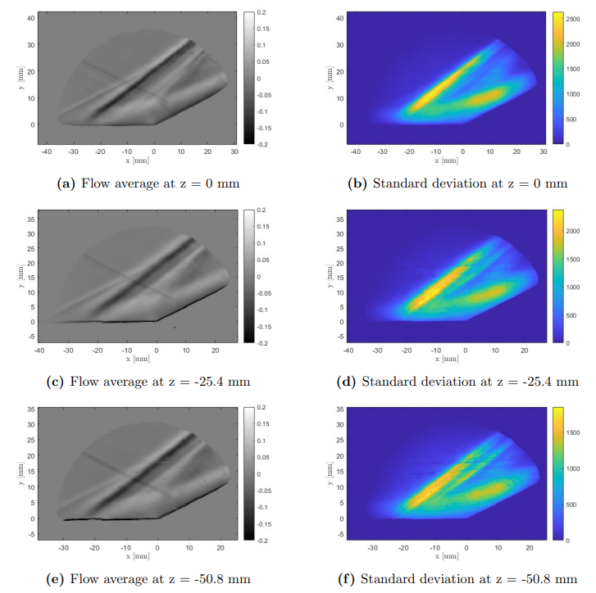
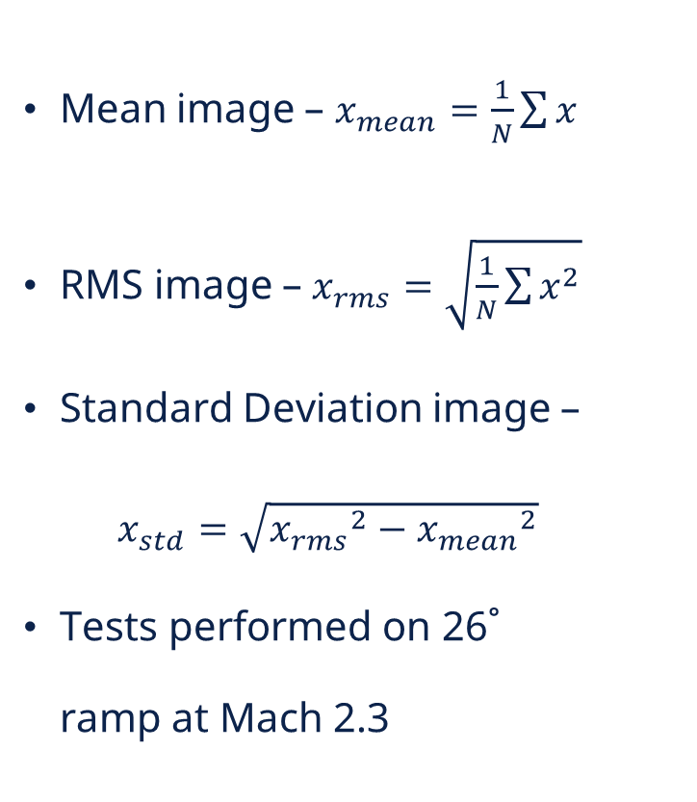
Analysis
Captured data –
Z-type Schlieren
Mean image – $x_{mean}=\frac{1}{N}\sum{x}$
RMS image – $x_{rms}=\sqrt{\frac{1}{N}\sum{x^{2}}}$
Standard Deviation image –
$x_{std}=\sqrt{{x_{rms}}^{2}−{x_{mean}}^{2}}$
Tests performed on 26˚ ramp at Mach 2.3
Focus Schlieren
Source: Maloney 2025
Notes:
J

Slide 9
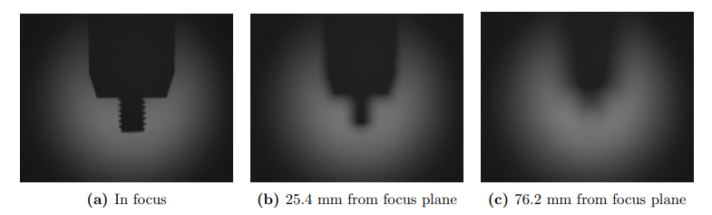
Conclusion
Z-type
  Easier and simpler set up
  Better suited close to floor or ceiling
Focusing Schlieren
  Captures specific areas of interest
  Helps negate spanwise edge effects
  Can view 3D structures
Source: Alec Maloney 2025

Slide 10
Acknowledgements
Dr James Threadgill
Dr Sathyan Padmanabhan
Michelle Coe and Space Grant staff

Slide 11
Thank you!
johnbruc@arizona.edu

